Slide 1
Risk Management APPlication
MINIMUM VIABLE PRODUCT (CRUD)
Tech Stack : Node.js, Express, Express-Handlebars and MySQL.

Slide 2
Scenario
Scenario Overview:
“Imagine you're tasked with developing a comprehensive Risk management application. This application aims to streamline task organization for individuals and teams by providing a user-friendly interface and robust backend functionality.”

Slide 3
Problem
A list of business risk owners. The database to be available to staff.
The application will grow into a bigger application whereby
they will be doing Ordering/Warehouse Management/Logistics and Finances on the application.

Slide 4
Requirements
Have an input screen whereby sales can input a Risk owner, telephone, code and comments/summary.
A screen where they can update and, or delete the risk owner.
It must save the information to an actual database.
It must have a middle layer due to additional security (3-Tier application – Front Layer, Services Layer and Repository)

Slide 5
01
PROBLEM VS. SOLUTION
HOW DID I GO ABOUT THIS ?

Slide 6
01
CRUD APP
02
Tech Stack
SOLUTION
03
TOOLS & LIBRARIES
04
BUSINESS MODEL
Create, read, update & delete
Nodejs, JavaScript, Express, MySQL & Handlebars, Apache
Visual Studio Code, XAMPP local server, phpMyAdmin
Simple

Slide 7
Backend Development
Create an MS-SQL database.
Set up a table for storing tasks information
Established a connection string to your database in your local server- I used Xampp sever for my local sql Display results from the server on the frontend.
Implement functions to insert new task data into the MS-SQL database and retrieve any updated task information.
Perform unit testing and verify that data is being saved and retrieved correctly from the database.

Slide 8
Frontend Development
Create JS components for the input screen and the update screen.
Implement a form on the input screen where staff can input a risk owner.
Manage user inputs and display results.

Slide 9
Documentation & Presentation
Upload the Prototype to a GitHub repository.
Document the setup, architecture, and how to run the application.
Provide clear instructions for running both the frontend and backend components.
Prepare a presentation to demonstrate the POC.
Show how the application meets the requirements and functions.

Slide 10
FEATURES
CRUD (GET, POST, UPDATE, DELETE)
Get Risk owners
Add the new Risk owners to the database
Update risk owners.
Delete the risk owners
*Additional feature - Activate and deactivate task from the web application. (The task still stays in the database but will not been shown in the actual web application if the database status is anything else besides “active”)

Slide 11
Minimum viable product
This is a proof of concept (POC) and can serve as the foundation for a larger application that may include more features like ordering, management, logistics, finances, etc

Slide 12
Vision & Goals!
I aimed to create an application that not only demonstrated my technical abilities but also showcased my creativity and problem-solving skills. By combining my educational background and coding experience, I was able to achieve my vision and create a user-friendly application that stands out in the competitive software development field.

Slide 13
Conceptualization & Architecture!
I focused on creating a simple intuitive and user-friendly interface. I considered the optimal organization of components and functionality, ensuring a seamless user experience. Additionally, I considered the scalability and maintainability of the application's architecture, allowing for future growth and enhancements.

Slide 14
Development Process
During the development process of my application, I followed an agile approach, breaking down the project into manageable tasks and iterations. I utilized industry-standard programming languages and frameworks, ensuring optimal performance and security. Regular testing and debugging were conducted to ensure a robust and error-free application.

Slide 15
Run the Application
Available Scripts
In the project directory, you can run:
Runs the app in the frontend development mode.
Type Node app.js in the terminal
Open http://localhost:5000 to view it in your browser.
for the backend – check that Xampp server is running
The page will reload when you make changes.
You may also see any lint errors in the console.

Slide 16
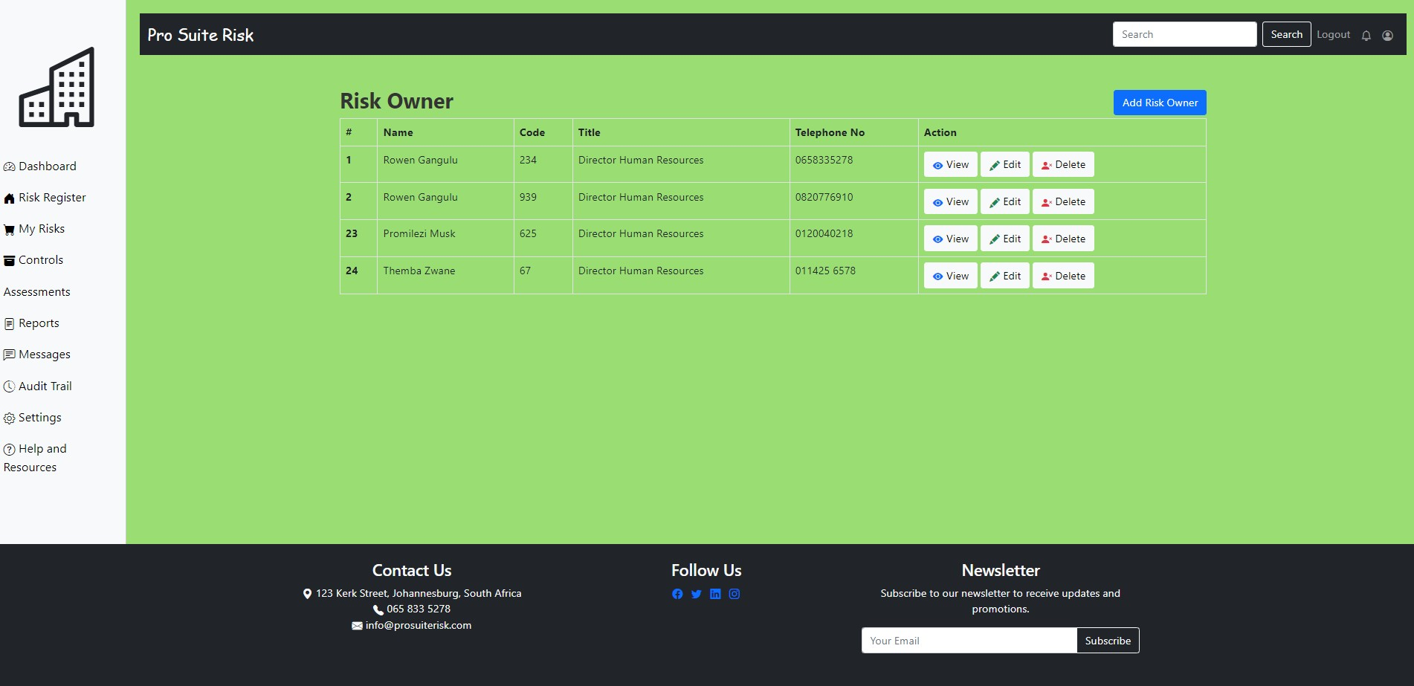
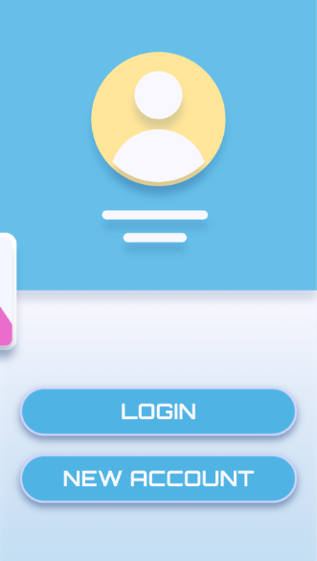
PRODUCT DEMO

Slide 17
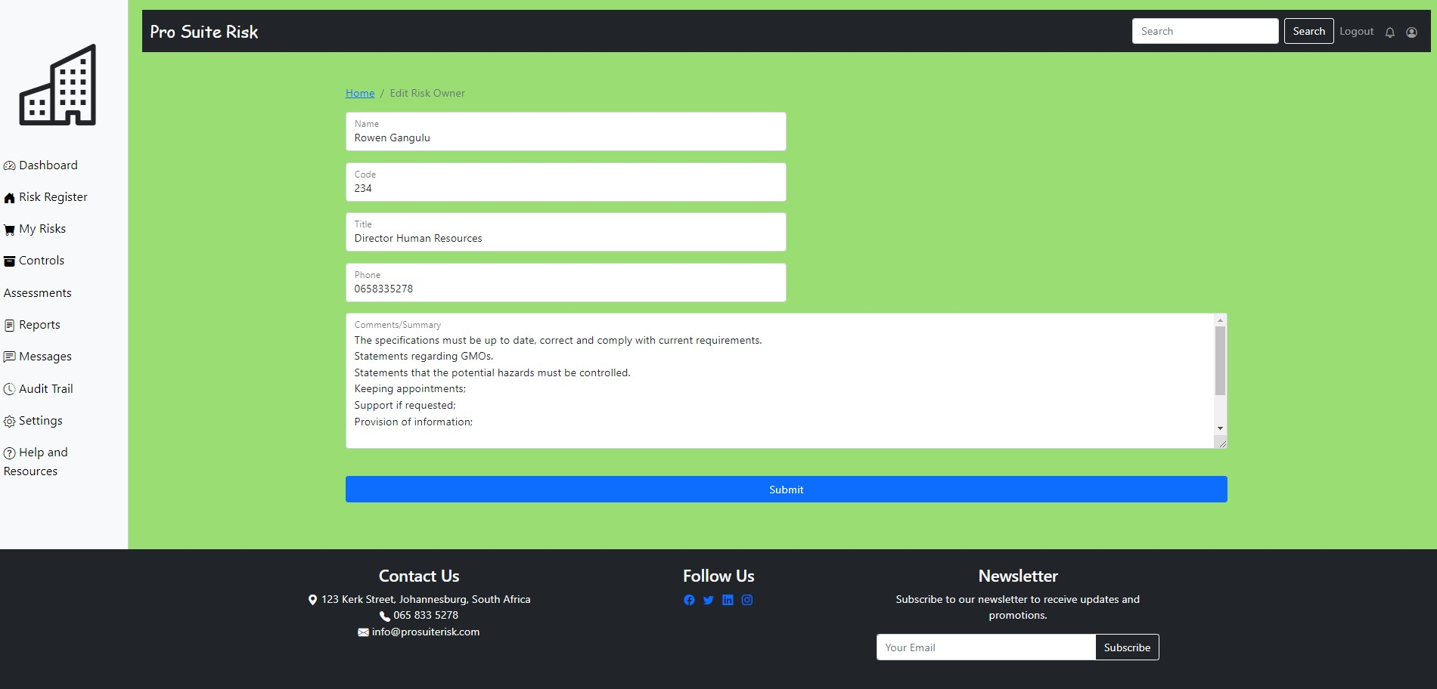

Slide 18
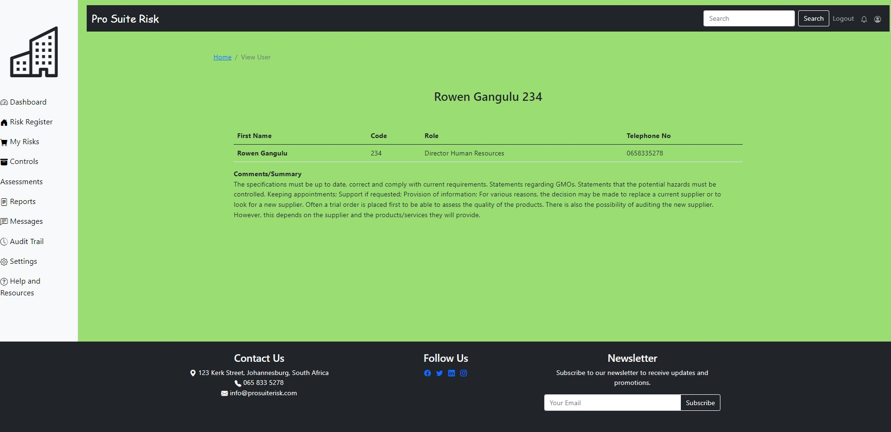

Slide 19
PRODUCT DEMO
The final MVP is available on my GitHub repository. Instructions on how to run the application are detailed in the Readme.md file.
For your convinience & upon request I can provide my personal directory of the Xampp folder, which includes the SQL DATA which you can copy replace in your Xampp directory or in phpmyadmin.
https://github.com/Raphael-devlpr/Task-Management-Application-2

Slide 20

THE DEVELOPER/ Code whisperer
RAPHAEL MUNAKI
“Good sense, disciplined by experience and inspired by goodness”

